Slide 1
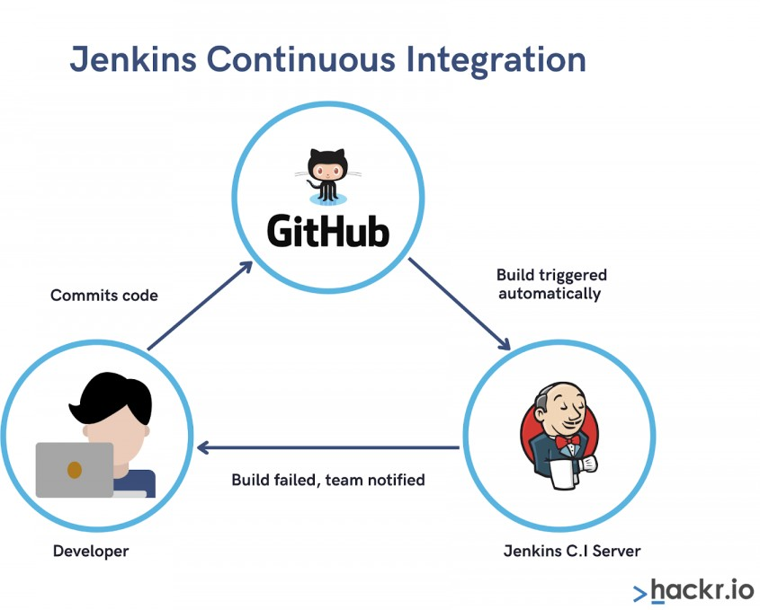
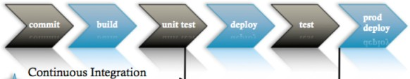
jenkins
For continuous integration and for continuous deployment we are using jenkins
CI : Continuous Integration
It is the combination of continuous build + continuous test
Whenever Developer commits the code using source code management like GIT, then the CI Pipeline gets the change of the code runs automatically build and unit test
Due to integrating the new code with old code, we can easily get to know the code is a success (or) failure
It finds the errors more quickly
Delivery the products to client more frequently Developers don’t need to do manual tasks
It reduces the developer time 20% to 30%
CI Server
Here only Build, test & Deploy all these activities are performed in a single CI Server Overall, CI Server = Build + Test + Deploy
CD: Continuous Delivery/Development

Slide 2
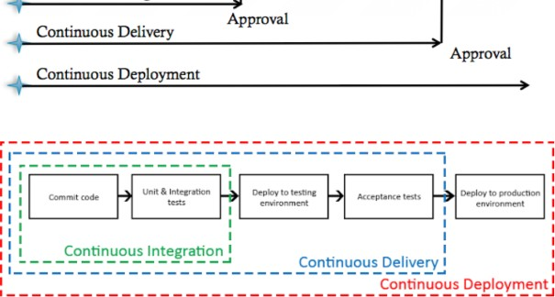
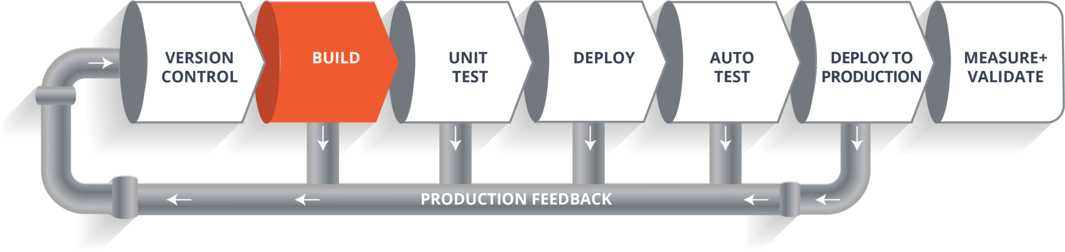
Continuous Delivery
CD is making it available for deployment. Anytime a new build artifact is available, the artifact is automatically placed in the desired environment and deployed
Here, Deploy to production is manual here
Continuous Deployment
CD is when you commit your code then its gets automatically tested, build and deploy on the production server.
It does not require approval
99% of customers don’t follow this Here, Deploy to production is automatic
CI/CD Pipeline
It looks like a Software Development Life Cycle (SDLC). Here we are having 6 phases
Version Control
Here developers need to write code for web applications. So it needs to be committed using version control system like GIT (or) SVN

Slide 3
Build
Let’s consider your code is written in java, it needs to be compiled before execution. In this build step code gets compiled
For build purpose we’re using maven
Unit Test
If the build step is completed, then move to testing phase in this step unit step will be done. Here we can use sonarqube/mvn test
Here, application/program components are perfectly worked/not we will check in this testing Overall, It is code level testing
Deploy
If the test step is completed, then move to deploy phase
In this step, you can deploy your code in dev, testing environment Here, you can see your application output
Overall, we are deploying our application in Pre-Prod server. So, Internally we can access
Auto Test
Once your code is working fine in testing servers, then we need to do Automation testing So, overall it is Application level testing
Using Selenium (or) Junit testing
Deploy to Production
If everything is fine then you can directly deploy your code in production server
Because of this pipeline, bugs will be reported fast and get rectified so entire development is fast Here, Overall SDLC will be automatic using Jenkins
Note:
If we have error in code then it will give feedback and it will be corrected, if we have error in build then it will give feedback and it will be corrected, pipeline will work like this until it reaches deploy
what is jenkins
It is an open source project written in Java by kohsuke kawaguchi
The leading open source automation server, Jenkins provides hundreds of plugins to support building, deploying and automating any project.
It is platform independent
It is community-supported, free to use It is used for CI/CD
If we want to use continuous integration first choice is jenkins

Slide 4
It consists of plugins. Through plugins we can do whatever we want. Overall without plugins we can’t run anything in jenkins
It is used to detect the faults in the software development It automates the code whenever developer commits
It was originally developed by SUN Microsystem in 2004 as HUDSON HUDSON was an enterprise addition we need to pay for it
The project was renamed jenkins when oracle brought the microsystems Main thing is It supports master & slave concepts
It can run on any major platform without complexity issues
Whenever developers write code we integrate all the code of all developers at any point int time and we build, test and deliver/deploy it to the client. This is called CI/CD
We can create the pipelines by our own We have speed release cycles
Jenkins default port number is 8080

Slide 5
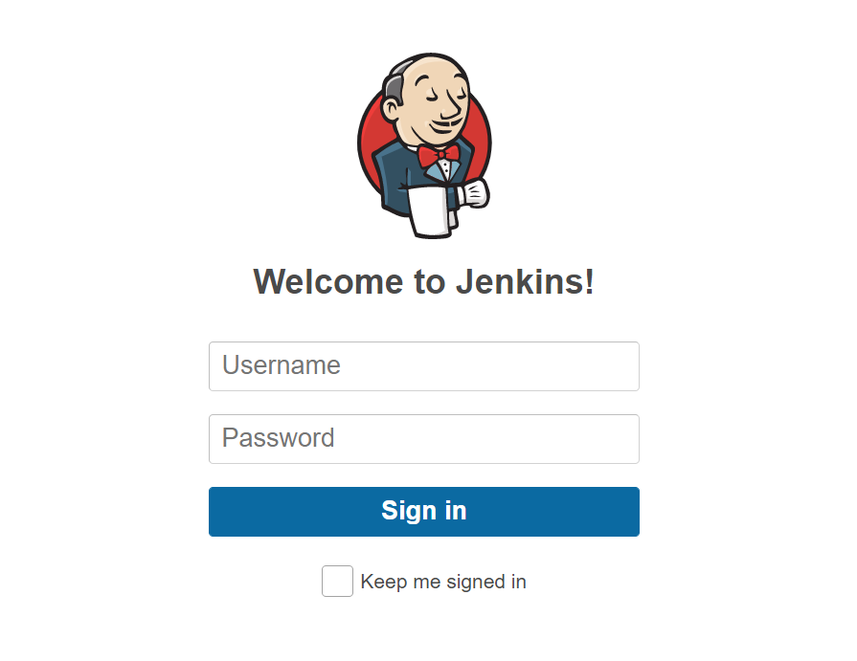
Sample Project – To Build A CI/CD Pipeline Using Jenkins
In this project, we will try to learn a basic CI/CD pipeline that is required to build a Java web application .war file by using Jenkins. To install Jenkins refers to the Jenkins installation.
Step 1: Login into your Jenkins account as shown below.
Step 2. Once logged in, the user will be redirected to the Jenkins console, here’s the reference for the same.

Slide 6
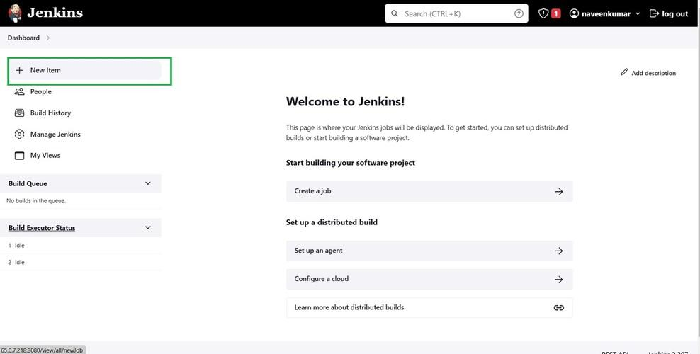
Step 3. To create a new project select the option available in the Dashboard which is “New Item” Refer to the image provided below:

Slide 7
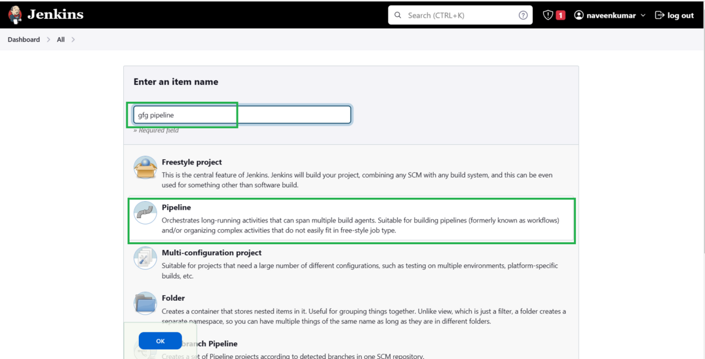
Step 4. Now a list of options will be visible on the screen, along with a field to name the pipeline. Add a suitable name and select the “Pipeline” option to proceed. Refer to this screenshot

Slide 8
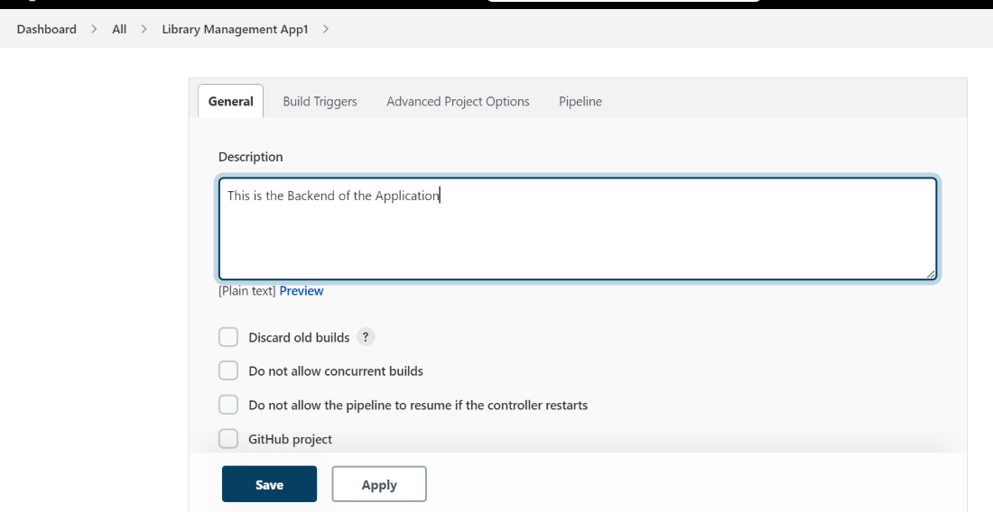
Step 5: Once redirected, the configuration page will appear. This is the most important page as here all the details will be filled in. At first, there is the General section where the user can add a description based on the project for which the pipeline has to be created. And establish the connection to compute from where the pipeline will access the project. Refer to the screenshot to understand better.

Slide 9
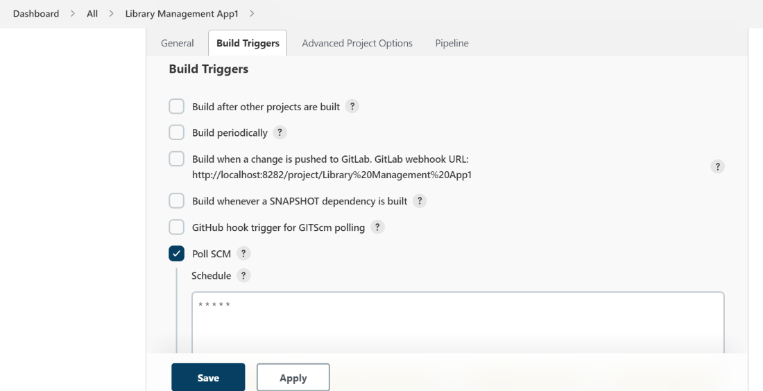
Step 6. Now comes the second section, i.e. “Build triggers”. Here, we need to specify the branch and repository and give the credentials too. And add additional behaviors if required so far. Refer to the screenshot to have a better understanding.

Slide 10
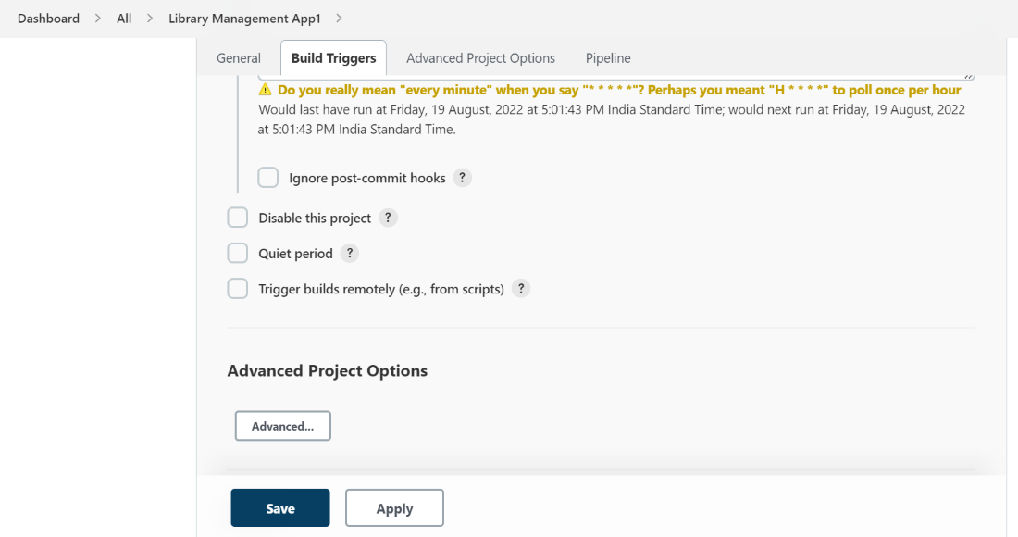
Step 7. The next section is “Advanced Project Options”, as the name suggests it is related to the special pipelines only, simpler projects do not require any specifications in this section. Please refer to the screenshot given below for the same.

Slide 11
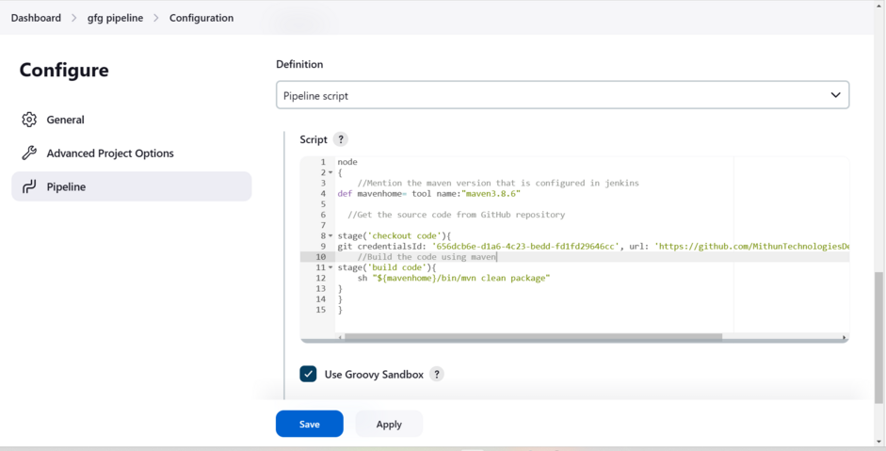
Step 8. This is the last section i.e. “Pipeline”. Here the user specifies from where the scripts will be imported including the path to the file, repository, credentials, etc. Refer to the screenshot attached below for reference.

Slide 13
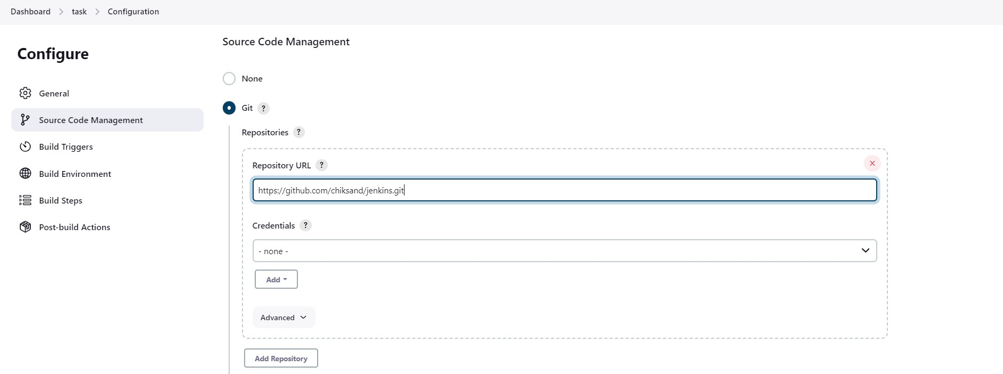
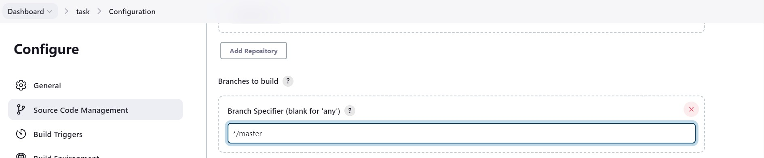
Create a new Job/task
Job: To perform some set of tasks we use a job in jenkins In Jenkins jobs are of two types
Freestyle (old) Pipeline (new)
Now, we are creating the jobs in freestyle
Click on create a job (or) new item
Enter task name
click on freestyle project (or) pipeline [Depends on your requirement]
These are the basic steps to Create a Job
Get the Git Repo
Follow above 3 steps then after
Copy the github repo url and paste in under SCM. It is showing error
So, now in your AWS terminal → Install GIT → yum install git -y
Whenever we are using private repo, then we have to create credentials. But right now, we are using public repo. So, none credentials
4. If we want to get the data from particular branch means you can mention the branch name in branch section.But default it takes master

Slide 14
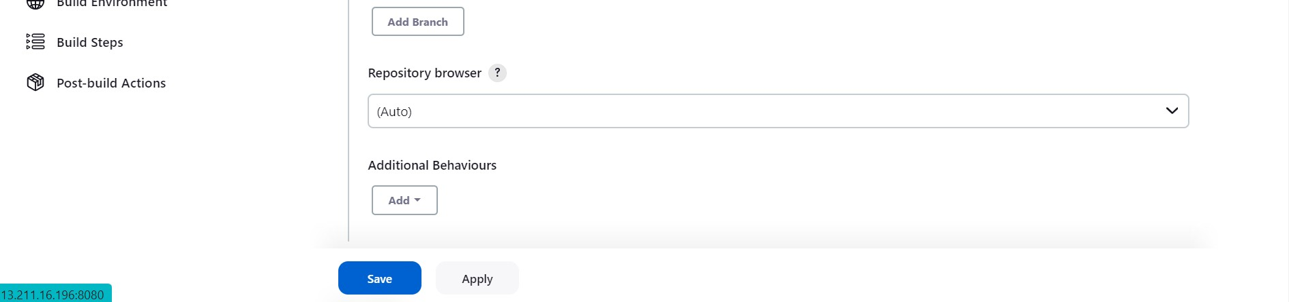
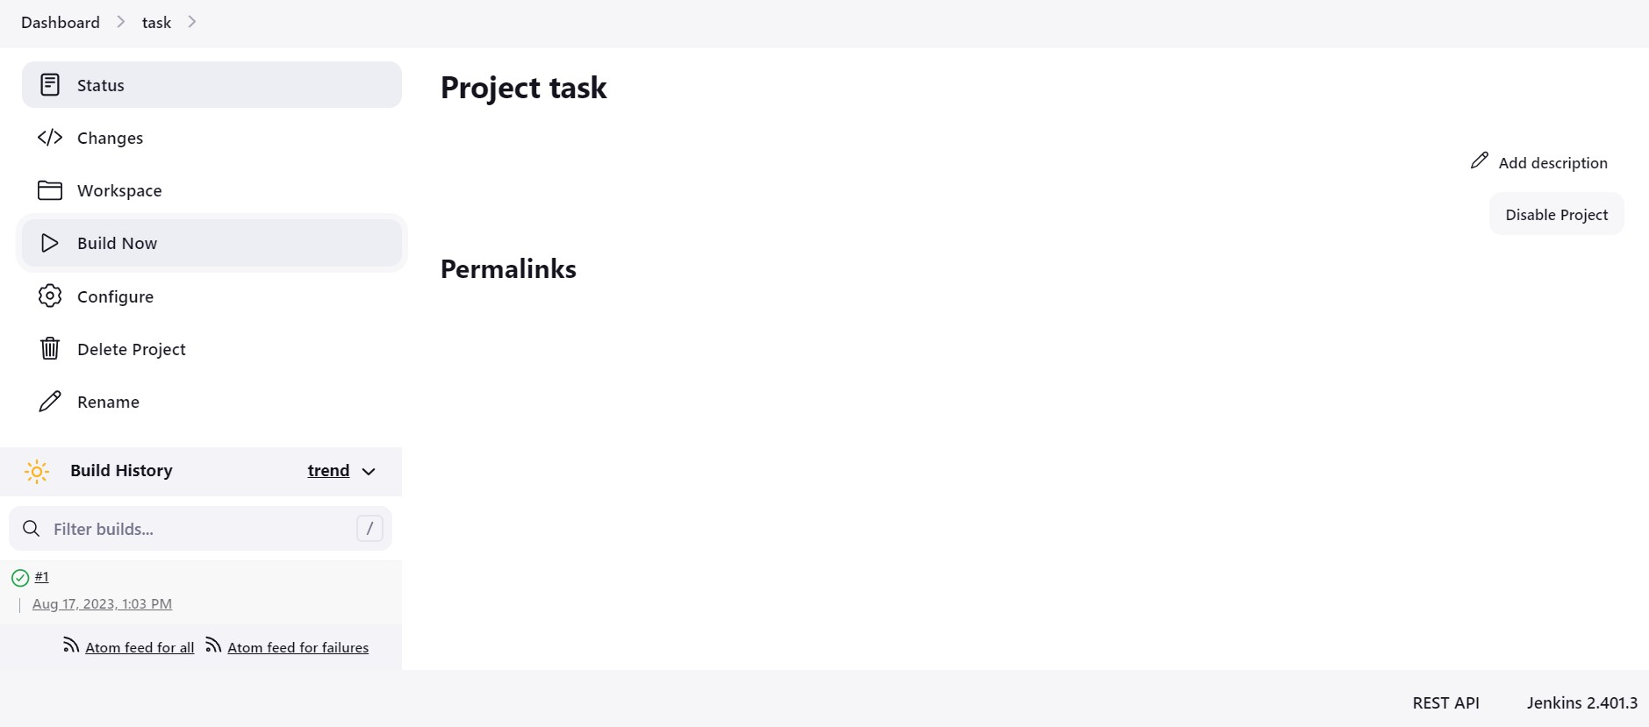
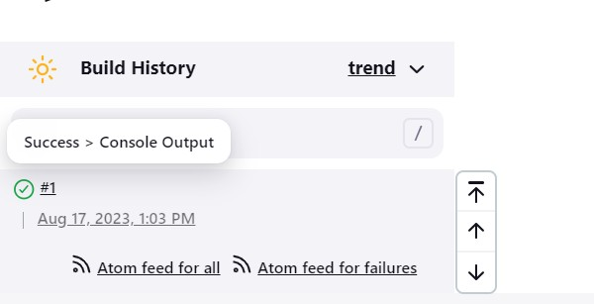
5. Click on save and Build now and build success
If you want to see output in jenkins. Click on console output i.e., (click green tick mark)
Schedule the Jobs
Build Periodically
Select one job → configure → build periodically Here, it is working on “CRON SYNTAX”
Here we have 5 starts i.e. * * * * * 1st star represents minutes
2nd star represents hours [24 hours format] 3rd star represents date
4th star represents month
5th star represents day of the week i.e.., Sunday - 0

Slide 15
Monday - 1
Tuesday - 2
Wednesday - 3
Thursday - 4
Friday - 5
Saturday - 6
Eg: Aug 28, 11:30 am, sunday Build has to be done → 30 11 28 08 0 → copy this in build periodically
If we give “ * * * * * “ 5 stars means → At every minute build will happen
If i want every 5 minutes build means → */5 * * * *
Click on Save and Build
Note: Here changes ‘happen/not’ automatically build will happen in “schedule the jobs” For Reference, Go to browser → Crontab-guru
Poll SCM
Select one job → configure → select Poll SCM
It only works whenever the changes happened in “GIT” tool (or) github We have to mention between the time like 9am-6pm in a day
same it’s also working on cron syntax Eg: * 9-17 * * *
Difference between WebHooks, Build periodically, Poll SCM (FAQ) Webhooks:
Whenever developer commits the code, on that time only build will happen. It is 24x7 no time limit
It is also working based on GIT Tool (or) github
Poll SCM:
Same as webhooks, But here we have time limit Only for GIT
Build Periodically:
Automatically build, whether the changes happen/not (24x7) It is used for all devops tools not only for git
It will support on every work Every Time as per our schedule

Slide 16
We have 3 types of pipelines
Freestyle pipeline
scripted pipeline
Declarative pipeline
Difference between freestyle and pipeline
In pipeline, we are writing the script for deployment. It is updated
In freestyle we are having manual options we can go through that. It is little bit old In real time we use 2 pipelines based on our requirement
Jenkins file - it is nothing but it contains the scripted (or) declarative code
Scripted pipeline syntax:
Eg: node {
stage (”stage 1") { echo “hi”
}
}
Declarative pipeline syntax:
pipeline {
agent any stages {
stage(”code”) {
steps {
echo “hi”
}
}
}
}
Here, In our pipeline we’re using declarative syntax

Slide 17
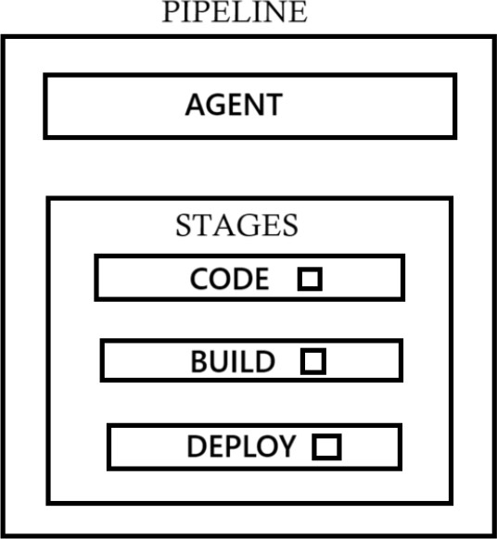
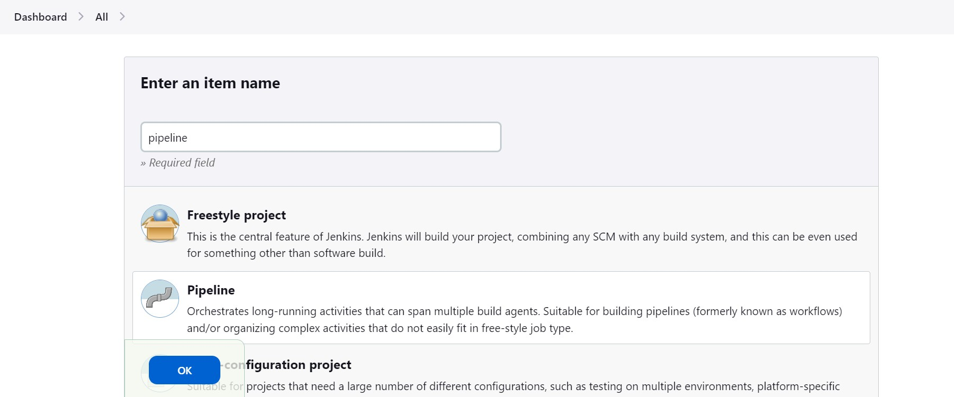
Declarative pipeline :
Here, pipeline is a block
In this block we have agents
Through agent we will decide in which server we have to run our tasks/job So, here we created a label, through label we will define
Inside the stages we have multiples stages
Eg: Code, build, test, deploy Inside every stages we have one step
Inside the steps we can write our code/commands
Launch jenkins server and open dashboard
1. Create a job → select pipeline → OK
Select pipeline → here we have to write the groovy syntax
Write the script
Single stage pipeline
Here, automatically indentations will take i.e, a tab space (or) 4 spaces

Slide 18
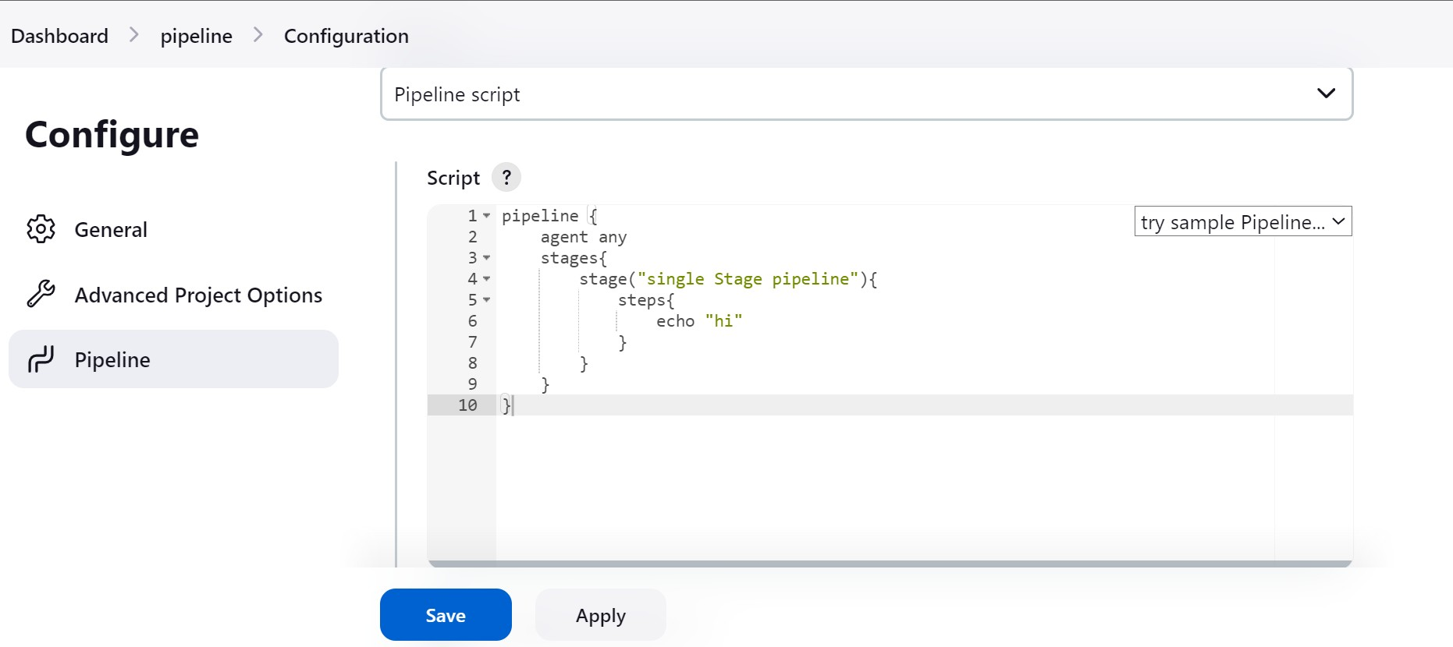
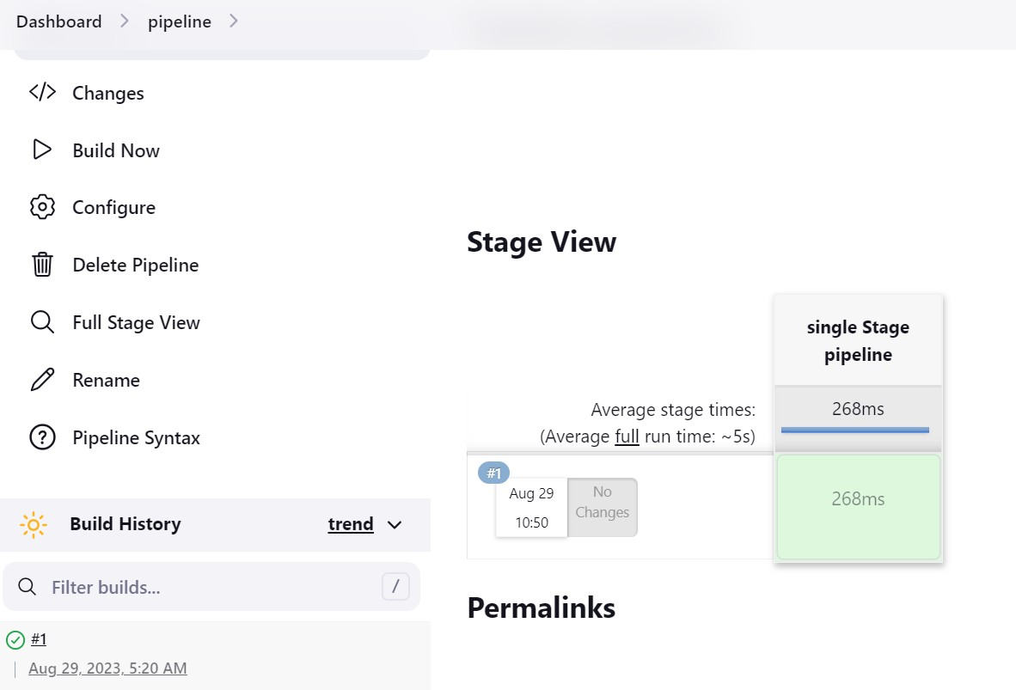
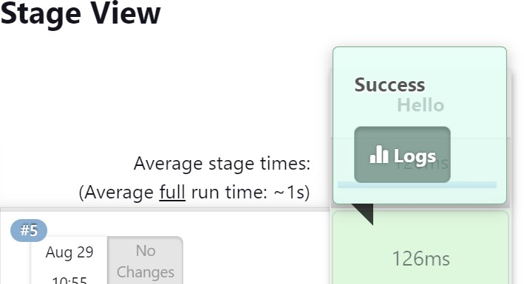
Once you write your script → build
GUI will be different. Here we can see step by step process
If you want to see the output, click on the build view click on logs

Slide 19
